Slide 1

Class : 4
SAS Tutorial
Presented By : Shashi Kumar

Slide 2
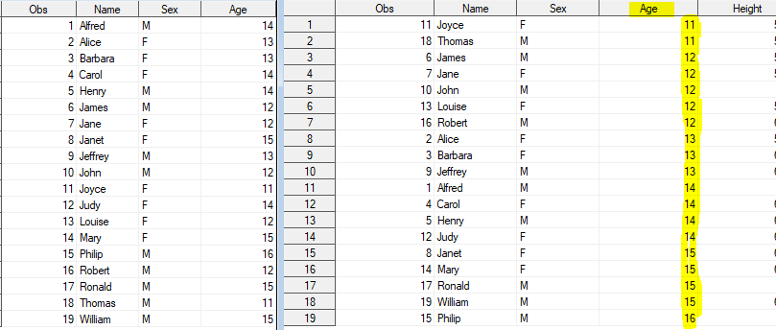
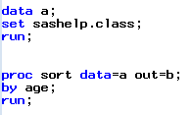
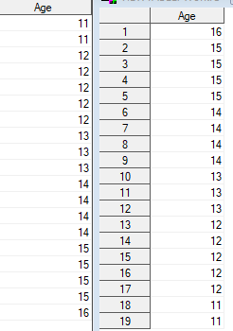

Sort / Order the dataset
If can also alter the default ascending order
by using descending followed by var name.
Caution:
If you don’t specify out= then parent dataset will be changed

Slide 3
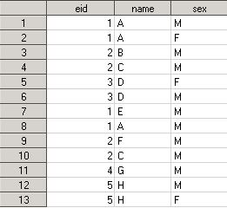
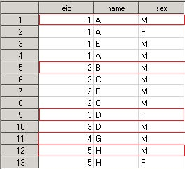
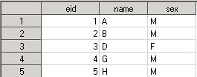
nodupkey, nodup & nouniquekey options
Three
Threes
Four
proc sort data=three out=four nodupkey;
by eid;
run;
proc sort data=three out=threes;
by eid;run;
nodupkey= it keep the first unique observation according to key variable(variable present in the by statement)

Slide 4
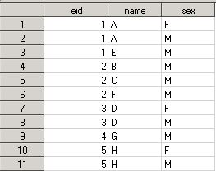
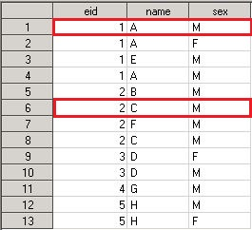

FIVE
SIX
proc sort data=three out=five nodup dupout=six;
by _all_;run;
nodup=It keep the first unique observation, if entire row is duplicate

Slide 5
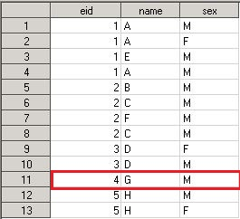


Seven
Eight
proc sort data=three out=seven nouniquekey uniqueout=eight;
by eid;run;
nouniquekey = It eliminate unique records based on by variable.
Duplicate record deleted from original dataset can be saved in another dataset by using the option uniqueout.

Slide 6
Combining SAS Dataset
Vertically
Horizontally
Multiple Set Statement
Append(Proc)
Concatenation
SQL Join
Hash object
Interleaving
Merge Statement

Slide 7
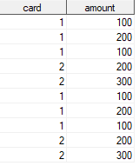


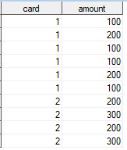
Appending & Interleaving
Appending is joining two datasets vertically.
Mention dataset name/s in single set statement to append.
Make sure the variable/s names should be same otherwise unwanted result would come.
Interleaving combines individual sorted dataset into one sorted dataset by specified variable in the by statement.

Slide 8
Merging
What’s need to have a successful merging??
There should be at least one key variable else unwanted result will populate.
Key variable values should be sorted in both dataset.
Key variable attribute i.e format, length , alignment should be same.
zero-to-one
one-to-zero
one-to-one
one-to-many
many-to-one
few-to-many
many-to-few
many-to-many
Types of Matched Merging

Slide 9
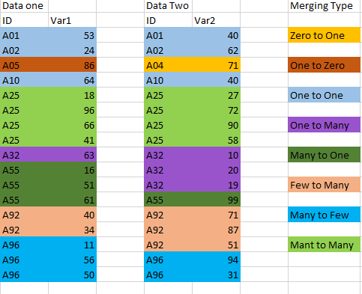
Merging
Different Cases of Merging
You can do it by merge statement
You can do it also with set statement
Be very careful when you have different #
of records in both tables i.e in few to many or few
to many cases

Slide 10
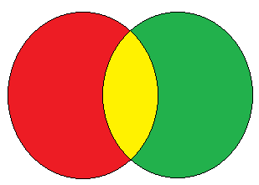
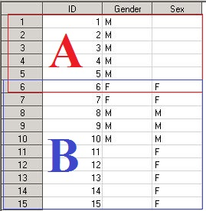
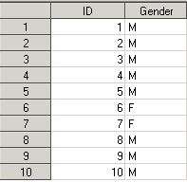
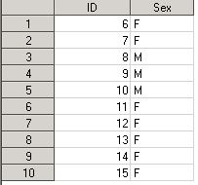
Full Join
Proc sql;
create table M2 as
select coalesce(a.id, b.id) as id, gender, sex
from A full join B on a.id = b.id;
quit;
data M;
merge A (in = x) B (in = y);
by id;
if x = 1 or y = 1;
run;

Slide 11
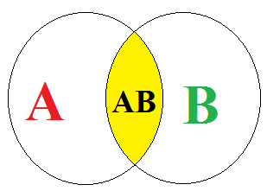
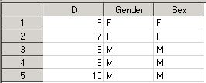
Inner Join
Proc sql;
create table M2 as
select coalesce(a.id, b.id) as id, gender, sex
from A inner join B on a.id = b.id;
quit;
data M;
merge A (in = x) B (in = y);
by id;
if x = 1 and y = 1;
run;

Slide 12
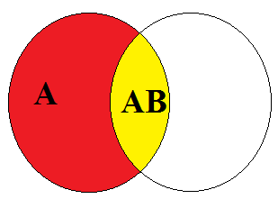
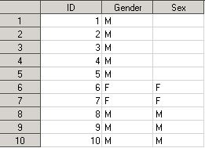
Left Join
Proc sql;
create table M2 as
select coalesce(a.id, b.id) as id, gender, sex
from A left join B on a.id = b.id;
quit;
data M;
merge A (in = x) B (in = y);
by id;
if x = 1 ;
run;

Slide 13
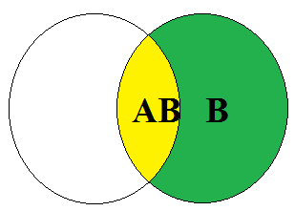
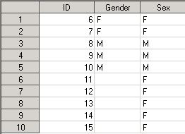
Right Join
Proc sql;
create table M2 as
select coalesce(a.id, b.id) as id, gender, sex
from A right join B on a.id = b.id;
quit;
data M;
merge A (in = x) B (in = y);
by id;
if y = 1 ;
run;

Slide 14
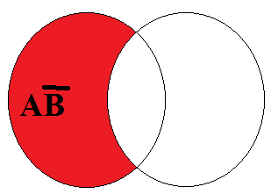
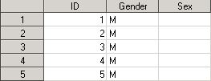
Non Matching From A
Proc Sql; create table Q2 as select coalesce(a.id, b.id) as id, gender, sex from A left join B on a.id = b.id where b.id is null; quit;
data M;
merge A (in = x) B (in = y);
by id;
If x=1 and y = 0 ;
run;

Slide 15
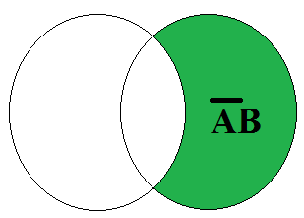
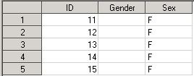
Non Matching From B
Proc Sql; create table Q2 as select coalesce(a.id, b.id) as id, gender, sex from A right join B on a.id = b.id where a.id is null; quit;
data M;
merge A (in = x) B (in = y);
by id;
If x=0 and y = 1 ;
run;

Slide 16
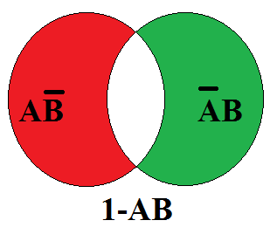
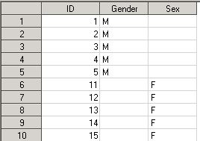
Non Matching From A and B
data M;
merge A (in = x) B (in = y);
by id;
If (x=0 and y = 1) or (y=0 and x = 1) ;
run;
Proc Sql; create table Q2 as select coalesce(a.id, b.id) as id, gender, sex from A right join B on a.id = b.id where a.id is null or b.id is null ; quit;

Slide 17
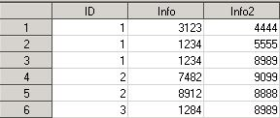
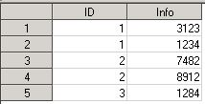
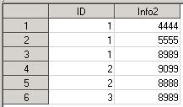
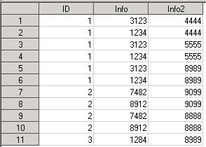
Many to Many
data combined;
merge dat1 dat2 ;
by ID;
run;
proc sql ;
create table combined2 as
select coalesce(dat1.id, dat2.id) as id ,info,info2
from dat1 full join dat2 on dat1.ID = dat2.ID;
quit;

